Slide 1
Customer Churn Analysis
Key Insights & Recommendations for Reducing Churn
Name : A P Bhadri Narayanan
Date : 31-08-2024

Slide 2
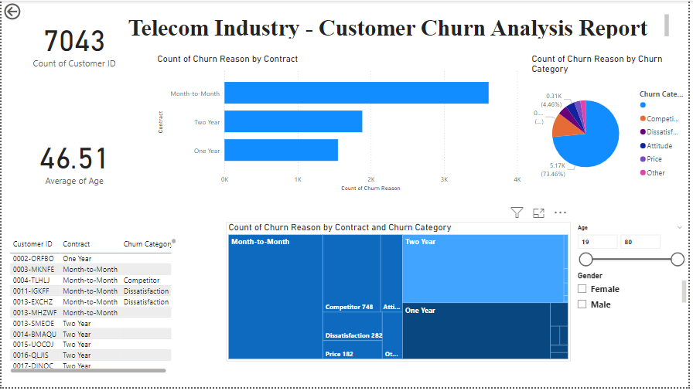

Slide 3
Overview of Churn Analysis
Churn Rate: 26.8%
Focus Areas:
Monthly Charges
Contract Types
Service Combinations
Goal: Identify churn drivers and suggest strategies for churn reduction.

Slide 4
Key Findings
High-Risk Contract Types:
Month-to-Month Contract: 81.91% churn rate
One-Year Contract: 11.68% churn rate
Two-Year Contract: 2.19% churn rate
Financial Impact of Churn:
Extra Data Charges for Churned Customers: ₹11,670
Top Revenue Customers:
Contribution of Top 5 Customers: ₹8,634.80 - ₹8,564.75

Slide 5
Demographic Insights
Age Group Influence:
Highest Average Monthly Charges: 25-34 age group (₹ 84.75)
Lowest Average Monthly Charges: 45-54 age group (₹ 77.78)
Gender & Marital Status:
Married Female Customers: Highest total charges - ₹3,859.38
Unmarried Male Customers: Lowest total charges - ₹1,992.27

Slide 6
Service Combination Impact
High Churn Services:
Unlimited Data Only: 383 churned customers
Streaming TV + Unlimited Data: Significant churn rate
Key Insight: Need to reassess the value of certain service bundles.

Slide 7
Recommendations
Incentivize Longer Contracts:
Offer discounts or loyalty rewards for customers on month-to-month contracts to switch to longer terms.
Target High-Value Customers:
Personalized discounts or premium services for high total charge customers.
Reevaluate Extra Data Pricing:
Revise data package pricing to address customer dissatisfaction and reduce churn.

Slide 8
Conclusion
Summary: Addressing key factors such as contract type, high-value customer retention, and service bundles can reduce churn and improve customer satisfaction.

